Slide 1

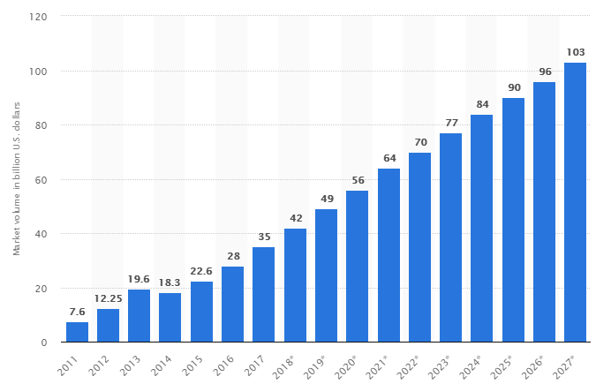
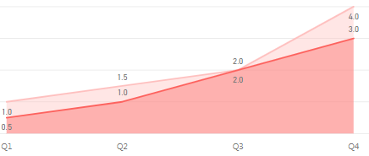
GS1 Canada Data Warehouse Project
1. Background and Purpose
4. Action Plan
According to Statista, the revenue of the Big Data industry will increase to 103 billion US dollars in size by 2027. With the current industry climate, GS1 Canada wants to build a “Data Warehouse”. Through successfully building D/W, GS1 Canada will obtain user experience about products, new revenue opportunities, and foundation to build “Big Data”.
# | Type | Issue | Role | Date
1 | Infra | Support technology (MongoDB/ETL tool/Business Intelligence tool) | System Architect | Jan ~
2 |  | Build GS1 Canada Data Marketplace (CMS) | System Architect | Feb
3 |  | Define prototype | System Architect | Feb
4 | Data | Define the report data and Visual Diagram | Data distributors (Sales/marketing/Finance/Executives … ) | Feb ~
5 | Training | Create Training module (Video/Mobile) with PowerApps | System Architect | Mar ~
6 | Guide | - Migration Procedure - Data Mapping Chart - Standard Operating Procedure - Report (Statistics) Service Request Form - Report Visualization Diagram and IO definition Form - User/Developer guide for GS1 Canada Data Marketplace | System Architect | Jan ~
7 | Project | Plan/Do Data Supply Pilot project | SA/DB/BI team | Mar ~ Apr
[Global Big Data market size]
49 B
103 B
2019
2027 year
2. Progress and Current situation
GS1 Canada:
- Understanding the importance of data utilization
- In the beginning stage of building Data Warehouse
- Preparing technical solutions with MongoDB (Storage)/Apach
NiFi(ETL)/Power BI (Business Intelligence)
- Defined the prototype for supplying data
5. Goal
6. Measures for Success
- Build D/W Tech Infrastructure
- Make Standard Operating Procedure (SOP)/Guides
- Raise participation rate by Quarter
[Weekly Avg Participate/Request count by a stakeholder]
- Is Infrastructure built
- Is GS1 Canada Data Share space built
- Is Standard Operating Procedure Prepared
- How many times stakeholders request BI Report work
- How many reports are in GS1 Data Marketplace
- What percent of BI report are used/reused
- How many stakeholders complete Training Module
3. Root-Cause Analysis:
[Comp. Business Intelligence Tools]
Quarter | Parcipate Count | Report Request
Q1 | 1 | 0.5
Q2 | 1.5 | 1
Q3 | 2 | 2
Q4 | 4 | 3
Type | Tableau | Power BI
Free Version | Public Version | Desktop Version
Cost | Creator: $70, Explorer: $35 on-premise/$42 cloud, Viewer: $12 on-premise/$15 cloud | Pro: $9.99, Premium: capacity pricing, charging per node per month
Good | Drill-down Visualization | Similar to Excel I/F, Included to Office 365 cloud Package
Bad | High cost for smaller Biz | Cannot share with Desktop
7. Purpose & Inquiry
- Each action plan needs another document in detail
E.G.: Data Supply Pilot project has different purpose,
duration from building Data Warehouse

Slide 2






















GS1 Canada Data Warehouse Project
System Diagram
Work-Process Diagram
GS1 Canada Data Warehouse
Suppliers | Inputs | Processes | Outputs | Consumers
- Data Distributors (Sales/marketing/Finance/Executives … ) - Data Consumer - Data Governance - Technology team - BI team | - Data Definitions - Visual Diagrams - I/O Definitions - Service Requests | - Define Report - Request Report - Take request - Gather Data - Build Report - Response Report - Distribute Report - Reuse Report | - Data Migration - Statistics Reports - SharePoint Web pages - PowerApps Apps - Social media pages - Outlook emails | - Executives - Sales people - Marketers - Finance team
Define
Gather
Share
Utilize
Power BI
Desktop
MongoDB
Power BI Cloud
Outlook
Apache NiFi
On-Premises
Gateway
Web / Mobile
BI Connector
SharePoint
PowerApps
Yammer
Start
Define/Visualize
Report
Request Service
Review
Migrate Data
OK
$$②$$
$$④$$
$$③$$
$$⑥$$
$$⑦$$
Distribute Report
Review
Build Report
Review
End
OK
OK
$$⑤$$
GS1 Canada Data Marketplace
- A GS1 Canada's Internal System that can be supplied and consumed GS1 Canada Statistics Reports.
- Reports should be reusable (Components) formats.
- Consumers can reuse reports, which were designed by other distributors
- Consumers can be distributors.
$$①$$
MS OFFICE 365
IBM DATA CENTER
Data Marketplace
Distribute to end-users
① Apache NiFi: Extract/Transform/Load data from RDBMS to MongoDB
② Power BI Desktop: Define/Visualize/Publish report
③ Power BI Office 365 cloud: Request data with encrypted credentials in scheduled-time
④ On-premises data gateway: Decrypted credentials and send query data to MongoDB
⑤ MongoDB: Extract/Send data to On-premises data gateway, which response data to Office 365 cloud
⑥ SharePoint/PowerApps/Yammer: Share/Promote Statistic Reports in GS1 Canada Marketplace
⑦ Outlook/Web/Mobile: Unutilized Statistic Reports by end-users
Table 1
Chart 1
Matrix 1
Chart 1
Finance
Reuse
Supply
Table 2
Chart 2
Matrix 2
Re-Distribute
Matrix 1
Table N
Chart N
Matrix N
Table 2
Marketing
Sales
Internal (Office 365 SharePoint/PowerApps/Yammer)
External

Slide 3
GS1 Canada Data Warehouse Project
Cost for D/W
Storage
: Recommended solution
Type | On-Premise |  | Cloud
Edition | Community | Enterprise | MongoDB Atlas |  |  |  | mLab
Version | 4.0 Series | 4.0 Series | 3.4, 3.6, 4.0 |  |  |  | 3.6
Provider / OS | Windows Server 2012 R2 | Windows Server 2012 R2 | AWS | Google CloudPlatform | Anzur | Trial | Community | AWS | Google CloudPlateform | Azur | Trial
RAM | 2 GB | 2 GB | 2 GB | 1.78 GB | 3.75 GB | Shared | Shared | 2 GB | 3.7 GB | 1.7 GB | Shared
Storage Capacity | 10 GB | 10 GB | 10 GB | 10 GB | 32 GB | 0.5 GB | 1 to 8 GB | 40 GB | 60 GB | 40 GB | 0.5 GB
Cost | Free | $1,000 per server yearly | $0.08/hr, $60/mo | $0.08/hr, $60/mo | $0.26/hr, $60/mo | Free | $15/mo | $ 180/mo | 360/mo | $200/mo | Free
Support | - | security, Ops manager | Scalability, Security, Recovery, Performance |  |  | Scalability | Availability, Backup, Performance |  |  |  | Backup
Data Transfer | Depends on IBM cloud | Depends on IBM cloud | Same Region: $0.01/GB | In region: $0.01/GB | $0.087/GB | Free | Free | Free | Free | Free | Free
 |  |  | Different Region: $0.02/GB | Worldwide: $0.12/GB
 |  |  | Internet: $0.09/GB
Reference link | https://docs.mongodb.com/manual/administration/production-notes/ |  | https://www.mongodb.com/cloud/atlas/pricing |  |  |  | https://mlab.com/plans/pricing/
Software
Connectivity
Type | Data Centralization | Data Visualization |  | Data Share
S/W | Apache NiFi | Power BI |  | Office 365
Edition | Open source | Desktop | Pro | SharePoint/PowerApps/Yammer
Cost | Free | Free | $9.99/User monthly
Type | Gateway On-Premise | BI Connectivity
 |  | MongoDB BI Connector | Simba MongoDB ODBC Driver
Cost | Free | Free | The number of installed processors
Description | Auto data refresh | Use MongoDB in Power BI | MongoDB Cloud BI Connector
Human Resources
MongoDB Administrator, ETL/Power BI/Office 365 experts

Slide 4
GS1 Canada Data Marketplace
1. Background and Purpose
4. Action Plan
2. Progress and Current situation
5. Goal
6. Measure for Success
3. Root-Cause Analysis:
7. Purpose & Inquiry

Slide 5
GS1 Canada Data Mart Piot Project
1. Background and Purpose
4. Action Plan
2. Progress and Current situation
5. Goal
6. Measure for Success
3. Root-Cause Analysis:
7. Purpose & Inquiry

